Slide 1

Title of the Project : Time Series Forecasting for Stock Market Prediction using LSTM and ARIMA
Students Name : M RAHUL, S SAI ASHWIN KUMAAR, N G SRI ADHAVAN.
Mentor Name : MS. V PREMA AP/AIDS.
Phase no: 1
Date of presentation : 07-10-2024

Slide 2
Previous Review Comments and Action Taken
Comment | Action Taken | Approval from Reviewer
Advised to learn the techniques in detail. | Working on learning about those techniques.
Suggestion on understanding on LSTM and ARIMA. | Learnt the overview.

Slide 3
Problem Statement
This project addresses the challenge of predicting stock prices by comparing ARIMA and LSTM models. It aims to improve accuracy through a hybrid approach to better capture market complexities.
Enhances stock prediction accuracy.
ARIMA for time-series forecasting.
LSTM handles long-term dependencies.
Mention the current status of the project – The project is currently in the technical exploration phase , Focusing on Understanding the LSTM and ARIMA model.

Slide 4
Top Source Articles (Literature)
[1] An Luo, Liang Zhong , Jianglin Wang, Yue Wang, Shaojie Li, And Weipeng Tai, “Short-Term Stock Correlation Forecasting Based on CNN-BiLSTM Enhanced by Attention Mechanism”, Journal Paper, Volume 12, ISSN: .2024.3369419

Slide 5
Features used from the Base Articles
[1] - LSTM captures long-term dependencies effectively.
[2] - RNN processes sequential stock data efficiently.
[3] - ARIMA models historical stock price trends.

Slide 6
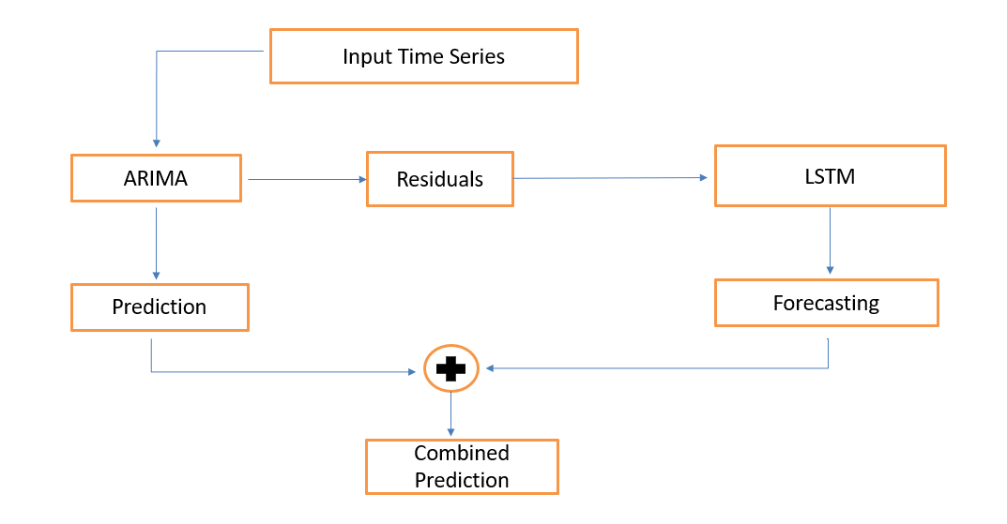
Architecture diagram

Slide 7
Timeline and Plan for future
Month 1(Nov): Data Collection and Annotation
Month 2(Dec): Data Preprocessing and Model Development
Month 3(Jan): Training and Optimization
Month 4(Feb): Testing, Evaluation and Documentation

